Slide 1
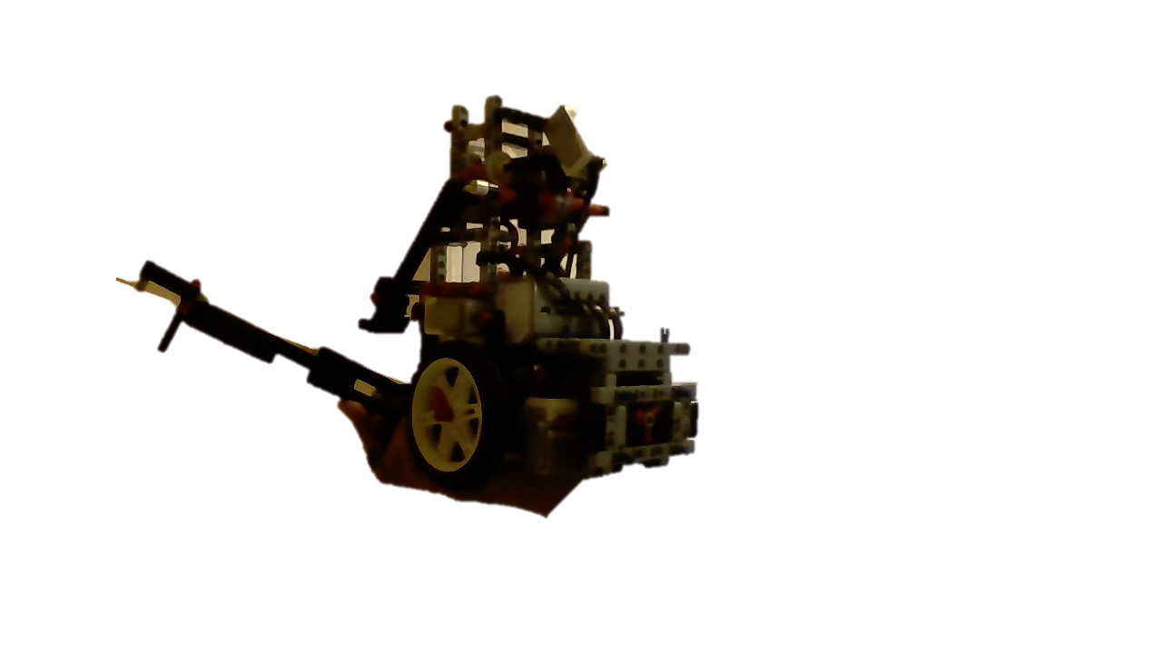
Science Project Title
Your name | Teacher’s name | School
The Attachments
The Robot
More Attachments
The Gearboxes
Step 2
Describe this step in your experiment
Step 3
Describe this step in your experiment
Step 4
Describe this step in your experiment
Gearboxes allow attachments in many different places.
The Upside-down Motors
Upside-down so that the robot is flat
The Compost Jig
Angled to guide the robot to compost
The Demolishing Building Jig
Curve to give the lever room to go down
The One-Way Door
Used to collect the Valuables
Used for a more compact robot design
Used to collect the compost
The Turtle Baginator
The Turtle Grabber grabs the Turtle and the Plastic Bag
Compost Collects the Compost Jig and the Demolished Building
Two-pronged so that the Compost Jig does not rotate
The slide launches the people.
Both are controlled by the arm at the top
Include results based on your experiments
Result 2
Result 3
The My Blocks
Conclusion
_MoveForward & _MoveBackward: Moves the robot forward or for a set amount of centimeters.
__SpinLeft & _SpinRight: Makes the robot spin left or right to a set angle.
_SeekLineForward & _SeekLineBackward : Makes the robot drive forward until it senses the line
_SquareLineForward & _SquareLineBackward : Makes the robot go forwards or backwards seeking the line and square with the line
Brief summary of what you discovered based on results
Indicate and explain whether or not the data supports your hypothesis
Works Cited
Include print and electronic sources in alphabetical order

